Slide 1
Class 3.12 – Orm’s!!
Class 3.12 – 1/28/19
Instructor: Hank dedona

Slide 2
Class 3.11 Recap
Inheritance part 3
Polymorphism
Interfaces
Default methods (java 8+ only)

Slide 3
Basics of relational databases
Relational databases store data in tables and have relationships between them using primary and foreign keys
All tables must have a primary key!
Foreign keys are usually the primary key of another table
Cheese
ID – number – auto incrementing (primary key)
Name - varchar (text)
Description – varchar (text)

Slide 4
Relationships
If we wanted to store the type of cheese as well in our cheese table, we could store the different types of cheese in a different table
New table: CheeseType
ID: number – auto-incrementing (primary key)
Type: varchar (text)
Once we have this new table, we need to add a new column to the original Cheese table to store the foreign key to the CheeseType table
CheeseType: number – foreign key to CheeseType.ID field

Slide 5
Using relationships with joins
In order to get all of the information of a cheese object across two tables, we need to JOIN them
For example if we wanted to select the fields from just the Cheese table, we’d use a SQL select statement like so:
SELECT ID, Name, Description FROM cheese WHERE ID = 7; // This will select the cheese with ID of 7
However, if we wanted to include the cheese type as well, we’d have to use a JOIN statement

Slide 6
JOINS!
Goal: Select all fields (name, description, cheese type)!
SELECT Cheese.ID, Cheese.Name, Cheese.Description, CheeseType.Type FROM cheese INNER JOIN CheeseType ON Cheese.CheeseType = CheeseType.ID
This is an example of an INNER JOIN, which will only return values that selects records that have matching values in both tables!
Note: There are outer joins, left and right outter/inner joins and more!

Slide 7
Orm – object-relational mapping
Allows for mapping between code objects and relational database tables
Databases (at least SQL database) store data in tables (with relationships)
Code (like Java) store data in objects
ORMs allow for creating, retrieving, updating and deleting (aka CRUD) objects to a database
Data layer (or service) between your code and the database
This code usually has classes/services to perform the CRUD

Slide 8
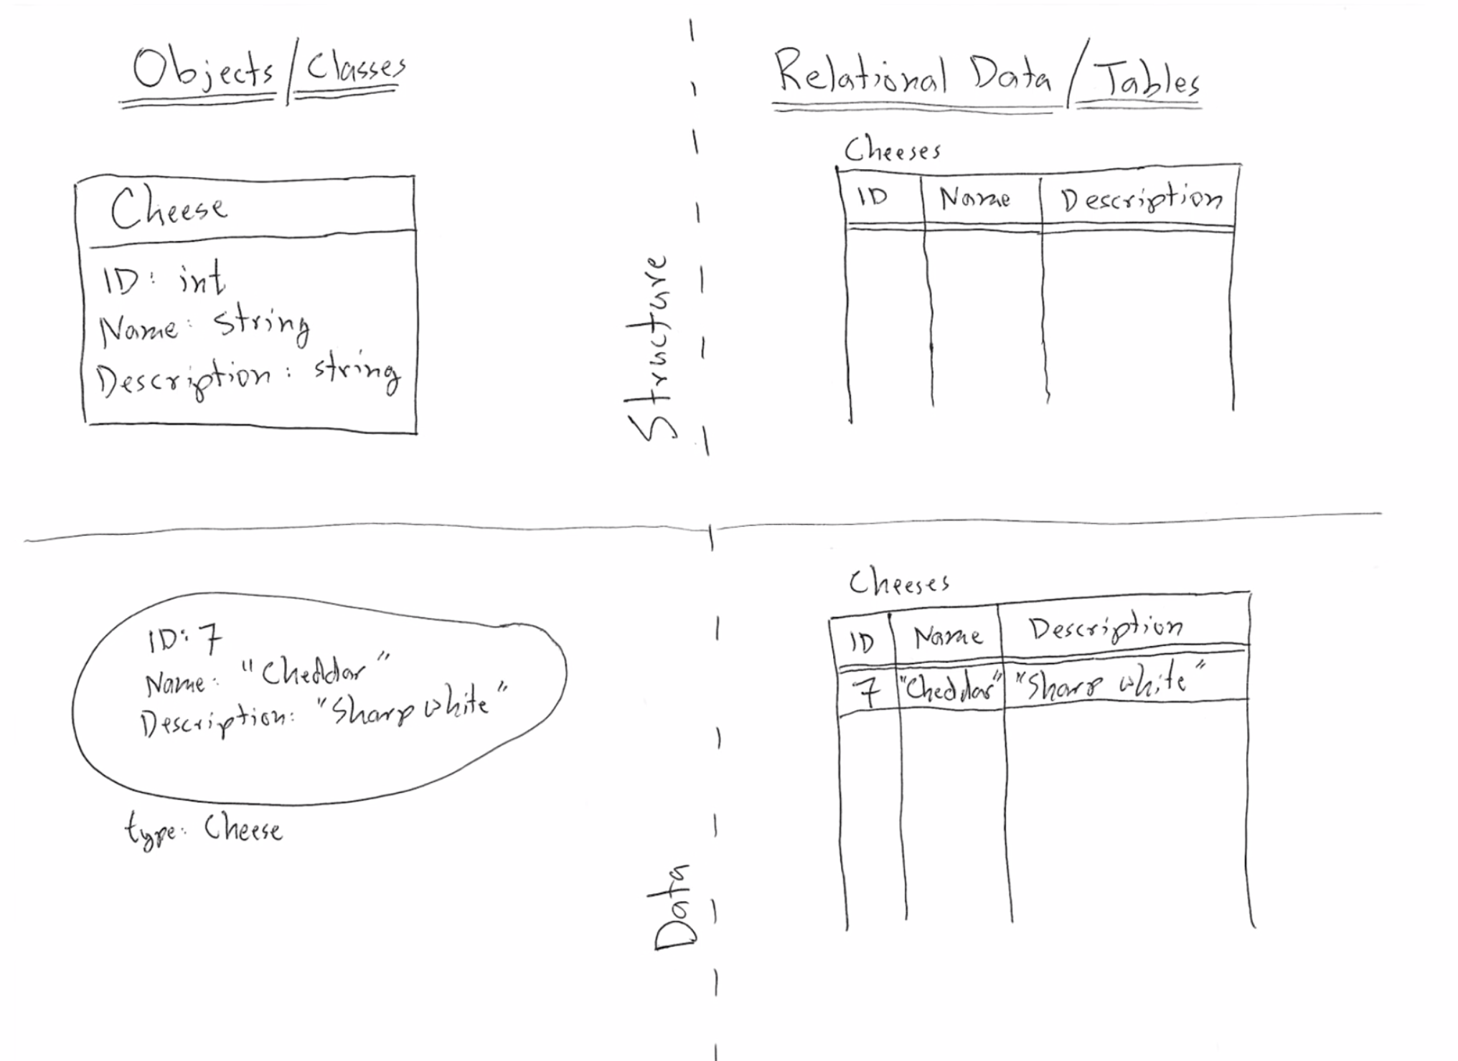
Data mapping cheese ☺

Slide 9
Saving (or creating)
Steps:
1) Create new object, for example Cheese cheddar = new Cheese(7, “Cheese”, “Delicous”);
2) Call into the DAO (Data access object) to save (or create) the object)
3) Save to database in DAO which maps the Cheese data fields to the relational database tables.

Slide 10
Reading
Retrieving is just as easy with ORMs
You can select by the identifier (in the previous example we used an ID of 7)
Note: Using the primary key is the fastest way to retrieve a row from a database table
The ORM will provide the construction of the Cheese object and return it to you populated with all of the data related to the cheese, even though you only provided the identifier.

Slide 11
Updating
Also pretty straight forward
Steps:
1) Retrieve cheese object from ORM (database)
2) Make changes
3) Call update method in DAO
4) Profit!

Slide 12
Deleting
Pretty straight forward, provide an ID (or entire cheese object) and the ORM will delete the row from the database for you!

Slide 13
JPA (Java persistence api)
The Java Persistence API is a Java specification for accessing, persisting, and managing data between Java objects/classes and a relational database.
Hibernate is the IMPLEMENTATION of the JPA specification that we use in this class (and is widely used in industry as well).
This allows for POJOs (Plain old Java objects) to be persisted (stored) to a database (like MySQL) using an ORM (like hibernate) (yay!).

Slide 14
Spring boot & jpa
Classes (POJOs) need to be annotated with the @entity annotation
This allows Spring Boot (and hibernate) to know that this class is going to be stored in a database (i.e. it’s an entity)
@Id – Declares a variable as the PRIMARY KEY
@GeneratedValue – Declares that the data layer will generate the value

Slide 15
crudrepository
Specifies the CRUD (Create, read, update and delete) methods
Requires the type (cheese) and the identifier type (Integer)
This provides the typical CRUD methods for a provided entity object, in this case Cheese

Slide 16
Cdi (Context and dependency injection)
Context and dependency injection
Highly recommend reading
Spring uses @Autowired
Javax uses @Inject
CDI allows for an inversion of control to allow the container and framework to create and manage the lifecycle of objects and provide them to us!

Slide 17
Dao usage
@Repository – This interface is a repository of data that is persisted
@Transactional – All methods should use transactions (either all succeed or rollback and fail)
findAll() – returns iterable with all objects
save(Object object)– saves your object
deleteById(integer id) – deletes an object by identifier

Slide 18
Next…
Spring boot persistence cheat sheet: https://github.com/LaunchCodeEducation/cheatsheets/tree/master/spring-persistence
Studio: https://education.launchcode.org/skills-back-end-java/studios/cheese-mvc-persistent/

